Slide 1
Low-Code/No-Code Development
Ravishka Rathnasuriya PhD Student

Slide 2
What is Low-Code/No-Code (LCD/NCD) Development?
Low-Code: Creating software with small amount of code by reducing the amount of traditional hand coding.
No-Code: Create software using graphical user interfaces and configuration instead of traditional computer programming. Closely related to Low-Code development platforms.
Applications are developed through model-driven engineering principles and take advantage of cloud infrastructures, automatic code generation, declarative and high level and graphical abstractions.

Slide 3
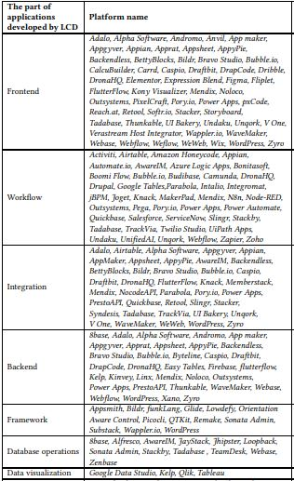
What platforms are used?
Bubble.io
Airtable
Wix ( Editor X)
WordPress
Outsystems
Microsoft Power Apps
Google App Maker
Salesforce App Cloud
Shopify
Zapier
Glide

Slide 4
Programming Languages Used
Java
JavaScript
C#
Python
HTML and CSS
Objective C
PHP
C++

Slide 5
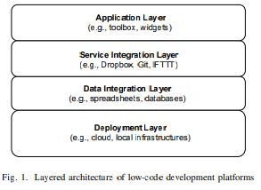
Architectural point of view
Consist of 4 main layers [2]: 1. Application Layer: Graphical environment 2. Service Integration Layer: Connect with different services by using corresponding APIs and Authentication Mechanisms
3. Data Integration Layer: data integration with different data sources 4. Deployment Layer: Deploy on cloud infrastructures or on-premise environments

Slide 6
Main Components
Grouped into three tiers [2]:
1. Application Modeler: Enabling the specifications of applications through provided modeling constructs and abstractions. Define applications.
2. Middle Tier: Takes the application model received from Application modeler and performs model management operations like code generations and optimizations. Consider involved services including database systems, micro-services, API connectors, model repositories of reusable artifacts.
3. External services: services that are integrated with the platform.

Slide 7
Implementation Units
API (backend)
Template (backend and frontend)
Component (frontend)
Services (backend)
Framework (Eg: “Loopback is an awesome framework that offers a full REST API to all CRUD available operations with zero code [1] ) (frontend and backend)
Widget (frontend)
SDK

Slide 8
Supporting technologies used
React Native : open-source mobile application framework
Node.js : free, open-source, cross-platform JavaScript runtime environment.
Apache Spark : Unified analytics engine for large-scale data processing
Server-side scripting : In web development that involves employing scripts on a web server and produces a response customized for each user’s request. Allow user to create website with zero code.
SOAP (Simple Object Access Protocol) : Messaging protocol specification for exchanging structured information in implementation of web services. (Eg: Bonita)
JSONata : open-source query and transformation language for JSON data.

Slide 9
Types and Kinds of Applications developed.
Mobile Applications
Web Applications
Integration Applications
Kinds of Supported Applications: Event Monitoring
Process Automation
Approval Process Control
Escalation Management
Inventory Management
Quality Management
Workflow Management

Slide 10
Domains Used
E-Commerce
Business Process Management
Social Media
Customer Relationship Management
Content Management System
Extract-Transform-Load
Entertainment
Robotic Process Automation
Medical

Slide 11
Benefits
Faster development
Ease of study and use
Lower IT cost
Rich and ready-to-use units
Newbie friendly
Improved system quality
Strong integration and expansion capability
Minimal efforts
Better user experience
Improved IT governance

Slide 12
Limitations and Challenges
High learning curve
High pricing
Lack of customization
Slow loading and publishing
Less powerful than programming
Complex issues still need coding
No access to source code
Limitations for experience developers
Vendor lock-in
Difficulty of maintenance and debugging
Need of basic programming knowledge

Slide 13
Development Process [2]
1. Data Modeling: visual interfaces to configure data schema by creating entities, establishing relationships, defining constraints, and dependencies using drag-drop facilities.
2. User Interface Definition: Configure forms and pages to define application views. Define and manage user roles, security mechanisms. Drag-drop capabilities are important to speedup development and render different views quickly.
3. Specification of business logic rules and workflows: Manage workflows among various forms and pages requiring different operations.
4. Integration of external services via third party APIs: Provide ways to consume external services through different APIs.
5. Application Deployment

Slide 14
Approaches to Built in Software Applications
UI to Data: Starts building the application by creating user interfaces and then linking it with needed data sources. Eg: Mendix, Zoho Creator, Microsoft Power Apps
Data to UI: Data-driven approach. Starts from data modeling and then builds the user interface of the application Eg: OutSystems, Salesforce App Cloud, Microsoft Power Apps, Appian.

Slide 15
Capabilities that a LCD/NCD platform can Offer and their features[2]
Graphical User Interface: Represents provided functionalities available in frontend. Features: Drag-and-drop tools, forms, point and click approach, pre-built dashboards, built-in workflows
Interoperability support with external services and data sources: possibility of interacting with external services. (Dropbox, Zapier, Office 365) Features: Interoperability with external services, connection with data sources
Security Support: Security aspects like authentication mechanisms, adopted security protocols. Features: Application, Platform security
Collaborative Development Support: Collaboration models. Features: on-line, off-line collaborations
Reusability Support: Enable to reuse already developed artifacts. Features: Built-in workflows, Pre-built forms/ reports, pre-built dashboards.

Slide 16
Capabilities and Features Contd.
Scalability Support: Scale up applications according to different dimensions. Features: Scalability on number of users, data traffic, data storage.
Business Logic Specification Mechanisms: Specify the business logic of the application modeled. Features: Business rule engine, graphical workflow editor, AI enabled business logic, API support
Application Build Mechanisms: Ways the application is built. Features: Code-generation, models at run-time.
Deployment Support: Deploying the modeled application. Features: Deployment on cloud, local infrastructures.

Slide 17
References
1. https://arxiv.org/pdf/2107.07482.pdf
2.https://www.researchgate.net/publication/344842798_Supporting_the_understanding_and_comparison_of_low-code_development_platforms
3. https://www.youtube.com/watch?v=jaRCENYBuYo
4. https://www.youtube.com/watch?v=JwM9NrePPMc

Slide 18
Acknowledgement
Dr. Wei Yang

